Slide 1
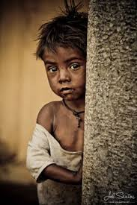
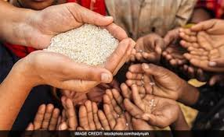
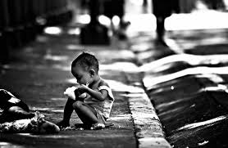
POVERTY ALLEVIATION SCHEMES
CLASS IX
Notes:
NOTE: To replace a picture, just select and delete it. Then use the Insert Picture icon to replace it with one of your own!

Slide 2
MEANING AND NEED FOR POVERTY ALLEVIATION SCHEMES
MEANING :
Poverty Alleviation Programmes aims to reduce the rate of poverty in the country by providing proper access to food, monetary help, and basic essentials to the households and families belonging to the below the poverty line.
NEED:
Several poverty alleviation programmes around the world affirm that socio-political inclusion of the poor and vulnerable, improvement of social security, and livelihood enhancement coupled with activities including promoting opportunities for socio-economic growth, facilitating gender empowerment and improving facilities.

Slide 3
MNREGA
Notes:
NOTE: To replace a picture, just select and delete it. Then use the Insert Picture icon to replace it with one of your own!

Slide 4
Add a Slide Title - 1
Mahatma Gandhi National Rural Employment Guarantee Act, 2005
It aims to provide 100 days of wage employment to every household.
It also aimed at sustainable development to address the cause of draught, deforestation and soil erosion.
One-third of the proposed jobs have been reserved for women.
The share of SC, ST, Women person days in the scheme are 23 per cent, 17 per cent and 53 per cent respectively.
The average wage has increased from 65 in 2006-07 to 132 in 2013-14.

Slide 6
PMRY
Notes:
NOTE: To replace a picture, just select and delete it. Then use the Insert Picture icon to replace it with one of your own!

Slide 7
Prime Minister Rozgar Yozana (PMRY), 1993 The aim of the programme is to create self-employment opportunities for educated unemployed youth in rural areas and small towns. They are helped in setting up small business and industries.
.

Slide 8
REGP
Notes:
NOTE: To replace a picture, just select and delete it. Then use the Insert Picture icon to replace it with one of your own!

Slide 9
Rural Employment Generation Programme (REGP), 1995.
The aim of the programme is to create selfemployment opportunities in rural areas and small towns.
A target for creating 25 lakh new jobs has been set for the programme under the Tenth Five Year plan.

Slide 10
PMGY
Notes:
NOTE: To replace a picture, just select and delete it. Then use the Insert Picture icon to replace it with one of your own!

Slide 11
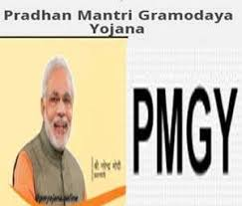
Add a Slide Title
Pradhan Mantri Gramodaya Yozana (PMGY), 2000.
An additional central assistance is given to states for basic services such as primary health, primary education, rural shelter, rural drinking water and rural electrification.

Slide 12
SGSY
Notes:
NOTE: To replace a picture, just select and delete it. Then use the Insert Picture icon to replace it with one of your own!

Slide 14
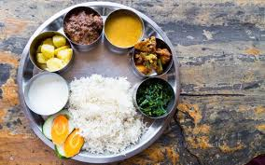
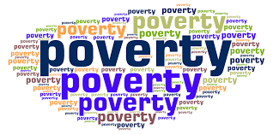
Add a Slide Title - 4
Swarnajayanti Gram Swarozgar Yojana (SGSY), 1999.
The programme aims at bringing the assisted poor families above the poverty line by organising them into self help groups through a mix of bank credit and government subsidy.

Slide 15
The current government strategy of poverty alleviation includes
Higher economic growth.
Increasing stress on universal free elementary education.
Declining population growth.
Increasing empowerment of the women and the economically weaker sections of society.
Schemes such as NREGA, PMRY etc.

Slide 16
THANK YOU

